Slide 1
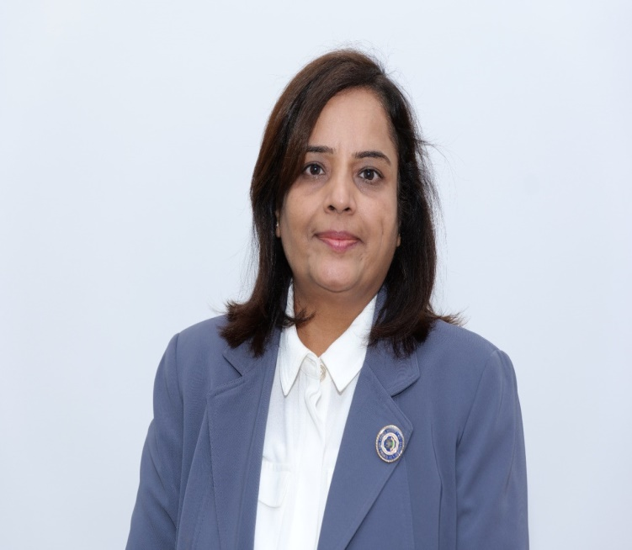
The Institute of Chartered Accountants of India (Set up by an Act of Parliament)
Women Members Excellence Committee
Organises
यशस्विनी - An IDOL- Live Webinar
CA. Priti Paras Savla
Chairperson, WMEC, ICAI
CA. Kemisha Soni
Vice Chairperson, WMEC, ICAI

Slide 2
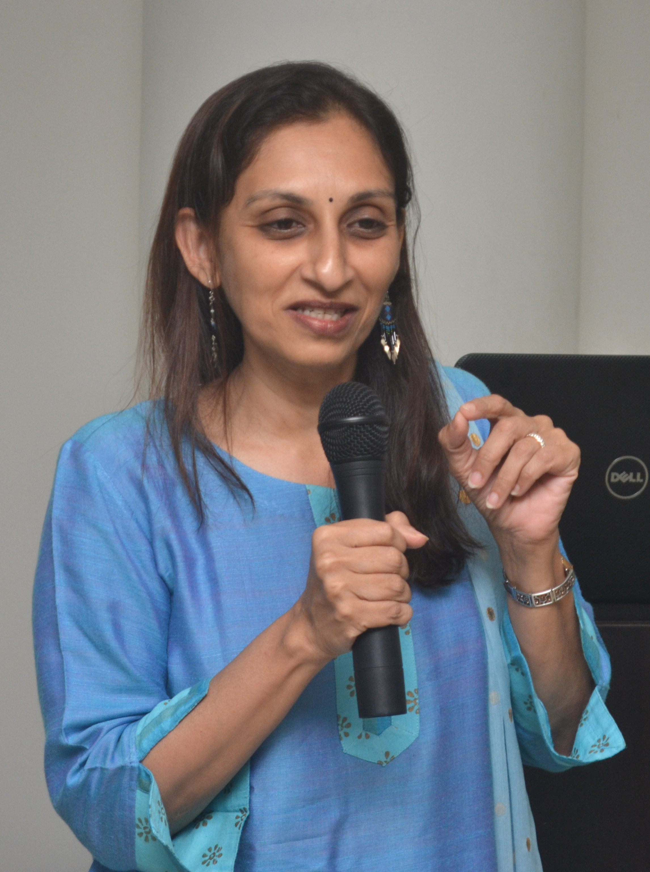
Internal Audit Trends and Opportunities
A Virtual Session organized by WMEC of ICAI
CA Nandita Parekh

Slide 3
Trends

Slide 4
1. Internal Audit (IA) Market in India is set to rise exponentially
Increase in the number of listed companies and other entities that require mandatory internal Audit
Introduction of new regulations that require a closer review of the processes adopted to ensure due compliance and reporting – PMLA, Data Privacy (DPDPA), LODR amendments, Charitable Trust Compliances, etc.
Regulators taking stricter action for non-compliances – serious implications of non-compliances
Maturing of the Start-up Economy resulting in significant fund raising and listing
Boards becoming more aware of the need for Integrated Risk Management and strong Internal Controls in all areas of business.

Slide 5
2. Co-sourcing Model of IA will gain ground as the preferred model
Talent shortage in Internal Audit and related fields, need for specialization in new age areas, need for rapidly adapting IA plans in response to emerging risks are factors that are leading to adoption of the co-sourcing model of Internal Audit
The division of work between the in-house team and external firms will tilt in favour of external firms – the model of a lean in-house team with one or more external firms to support the IA plan will be prevalent.

Slide 6
3. IA will be expected to focus on non-financial audit areas
Some of the areas that will require greater IA attention:
Data Privacy Compliances and readiness review
Cyber Security Framework – resilience and threat-response processes
Culture Audits giving due consideration to remote work scenario
ESG framework and impact assessment framework
CSR Audit
Fraud Risk Assessment

Slide 7
4. IA will be expected to understand new age risks and embrace technology
Climate risks
Energy and resources crisis
Digital Disruption Risk
Geo-political risks impacting supply chains and markets
Cyber threats
AI led redundancies and deep fakes

Slide 8
5. Independent directors will play a greater role in determining IA scope and compensation
Independent directors are expected to drive the Internal Audit agenda in view of increasing expectations from the Audit Committee and the Board.
The Board will seek independent assurance on internal controls, adequacy of risk management and fraud prevention controls from internal auditors rather than rely on management certification.

Slide 9
6. Standards and Certification will gain importance
A growing Internal Audit profession will require a well-structured set of standards to bring in consistency and ensure desired quality. Standards of Internal Audit (SIAs) will gain importance and will form the basis of conducting Internal Audit.
There is a need for avenues for structured formal training on internal audit to create the required talent pool – formal certification in Internal Audit, Risk Management and Forensic Audit will see a rise in demand.
Globally accepted certifications will enable professionals to seize opportunities for undertaking international assignments or seek job opportunities abroad.

Slide 10
7. Composition of IA teams will change
IA teams will need to become broad based, drawing skills and expertise from diverse fields – specialists in data privacy, cyber security, supply chain, third party risk management, social media experts, forensics, ESG will form part of IA teams.
IA teams will become younger and will include freelancers and gig workers.
More women will rise to leadership positions in IA – greater diversity and inclusivity will be achieved.
Ample opportunities will be available for dynamic, forward looking tech savvy SME firms to grow their Internal Audit and related consulting practice.

Slide 11
Opportunities

Slide 12
Internal Audit Opportunities
Regulations Driven or Compulsory
Need Driven or Voluntary
Listed companies
Companies meeting certain criteria of turnover, borrowing or capital
Financial Sector covered by specific regulators – Banks, NBFCs, insurance Companies, TPA, Mutual Funds, AMCs etc.
Complex regulations and serious consequences
Rapid changes in business environment – supply chain disruptions, high talent turnover, digital disruption, climate change consequences, cyber crimes.
Rapid changes in regulatory environment – PMLA, MSME, ESG, FCRA, Data Privacy, Charitable trust laws
Changes in aspirations of owners/management – transparency, IPO, listing, fund raising, selling the business.

Slide 13
The Platform of “Compulsory”
The regulator has created the market – you have to only seize the opportunity.
Opportunity may arise in many ways:
A new entity requiring mandatory IA, that does not have an existing IA function
An existing entity that has crossed the milestones that now require mandatory IA
An existing entity that periodically rotates Internal Auditors for select areas or for the entire entity
A carve out from exiting IA scope – say, IT systems audit, or Related Party Compliance Review, on Data Privacy Audit etc.

Slide 14
Exploring the “Mandatory” Space
Entities that are mandatorily required to have Internal Audit always look out for good, effective Internal Auditors.
Most of the companies practice audit rotation of some kind
In the broader space of Internal Audit, companies give out multiple sub-audits – CSR audit, treasury audit, IT audit, IFC/IFCR testing, third party audits, etc.
The regulators often also mandate who can perform Internal Audit and how it is to be performed – some internal audits have to be done inhouse, some have to be compulsorily out-sourced; but a large number of organizations follow the co-sourcing model, creating ample opportunities for Internal audit practioners.

Slide 15
The Power of “Voluntary”
Organizations and Managements that seek Internal Audit voluntarily are likely to value Internal Audit more. Chase the voluntary Internal Audit space rather than focusing only on the compulsory side.
Examples – start ups, pre-IPO companies, LLPs, large charitable trusts, hospitals, educational institutions, professional associations, clubs, multi locational businesses, professional firms…. These potential opportunities are everywhere!

Slide 16
This session is about making a leap

Slide 17
Small assignments executed well will bring in larger assignments

Slide 18
Can we work on an Image Change?
FROM ALWAYS FISHING FOR FAULTS…
…TO SOMEONE WITH A MACRO VIEW WITH ABILITY TO VISUALISE MACRO ISSUES AND EXTERNAL CHALLENGES
Notes:
Invite attention to recent blog of Richard Chambers – we are not organization’s cops. We are here to enhance and protect value.

Slide 19
Each observation a stitch, the final presentation, a well-woven fabric…..
Notes:
We used to get stuck with individual findings… with use of technology and more senior time on the assignment, we shifted to noticing trends; this is what the management really wanted.

Slide 20
Internal Audit Findings – Look for Trends and Patterns
The damage done by an error or a miss-out at an operational level can be contained.
The failure to spot a trend or a change in the pattern can crumble the entire organization.
Notes:
Important trends such as increase in online sales compared to store based sales from 12 % to 32 % - but no change in allocation of ad spend between digital ads and print media ads. Another example – increase in food delivery, resulting into empty tables at restaurants…. Can the physical space be utilized better? Can the delivery channel be made more efficient?

Slide 21
Technology – Our world has changed
Notes:
Important for us to demonstrate use of technology in our own work.

Slide 22
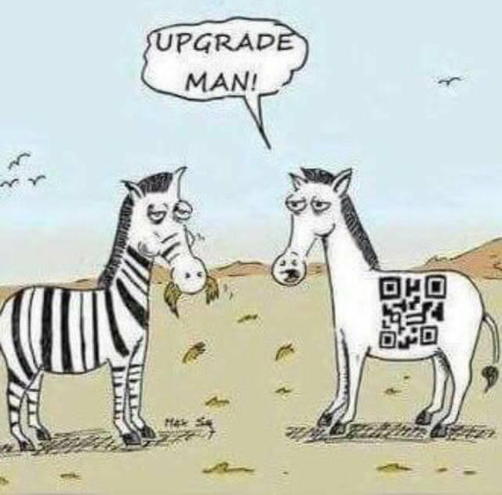
Let Us Understand and Embrace Technology
Notes:
This is an area for collaboration. If some of INAA member firms converge on tech tools used for analytics, audit management etc there could be a lot of learning and synergy.
Automation experiments and showcasing. Walk the talk.

Slide 23
Let us have the courage to address the key Issues
Or a mere mouse??
Is it an Elephant
Notes:
Too much focus on low risk items, non-consequential issues – we may miss the larger picture altogether.

Slide 24
Shift Conversations from Technical to Softer Issues
In which areas do you feel the maximum talent shortage?
Can your business be transformed to digital platform? How different would it be?
Are your people being skilled for jobs of the future or will you need to deal with redundancy?
Will changes in immigration policies, labour laws or trade restrictions impact your organization?
Do you have vibrant fraud risk assessment – do you have defined processes for dealing with suspected frauds?
How good is your whistleblower policy?
Notes:
Sensitive macro issues take the debate from tactical to strategic levels. Let us talk of issues that interest the management and the Board members.

Slide 25
Move from Tangible Findings to Intangible Perspective…..
Notes:
Time to move over form counting what can be counted.

Slide 26
The Human Factor
Loyalty
Bribery & Corruption
Ethics
Innovation
Adaptabiliy
Notes:
No organization as a policy will state that we encourage bribery. But if the employees are allowed to claim expenses that were never incurred or give expensive gifts to customers for pre-sharing pricing information or in return of award of contracts…. The message that is being sent out is no different.

Slide 27
To conclude….

